Slide 1
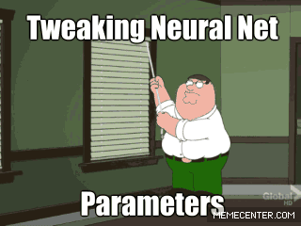
Convolutional neural networks
And other cool stuff if we have enough time

Slide 2
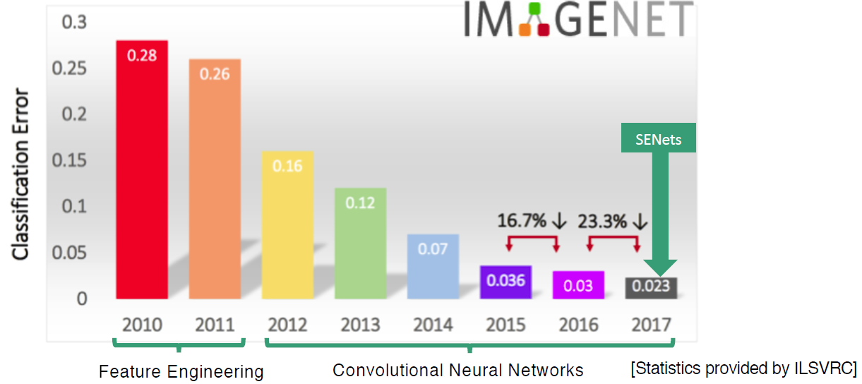
What are SENets?

Slide 3
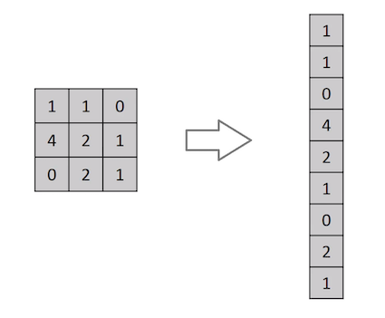
Convolutional Neural Network (CNN)
Until now: Flatten image
Why not?

Slide 4

Convolutional Neural Network (CNN)

Slide 5

Convolutional Neural Network (CNN)
kernels

Slide 6

Convolutional Neural Network (CNN)
stride
padding

Slide 7

Convolutional Neural Network (CNN)
pooling

Slide 8

Convolutional Neural Network (CNN)
Pooling
Good resource

Slide 9
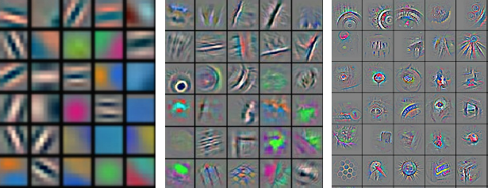
What do kernels learn?

Slide 10
Keras example

Slide 11
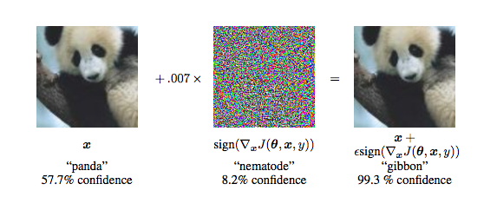
Adversarial examples

Slide 12
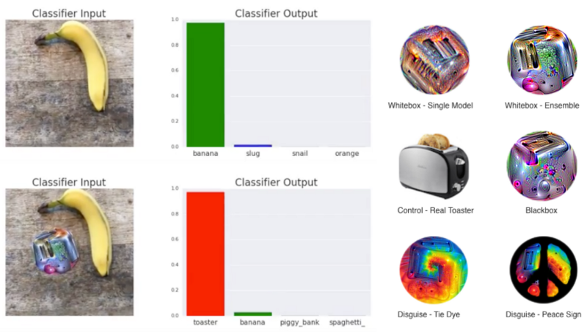
Adversarial examples
Power of invisability

Slide 13
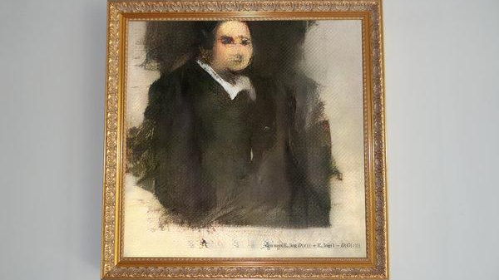
GAN ART
Full story

Slide 14
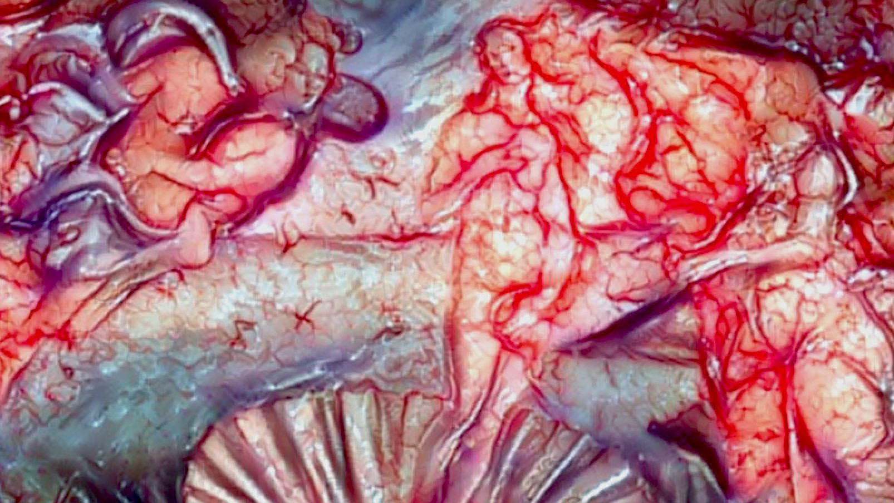
GAN ART
Algorithmic horror

Slide 15

GAN ART
Style transfer in video

Slide 16
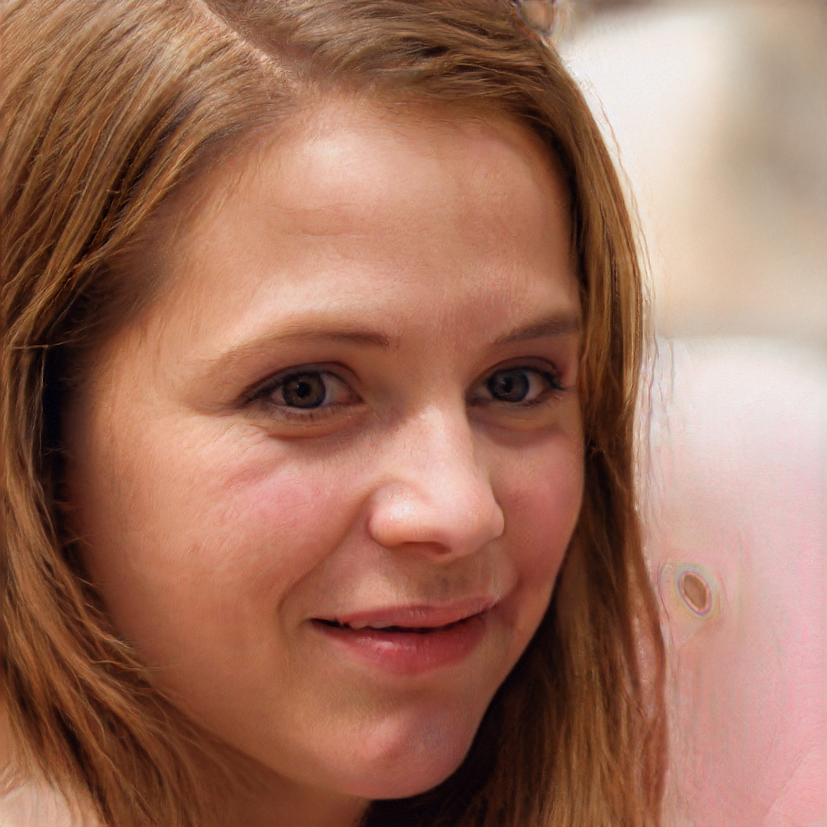
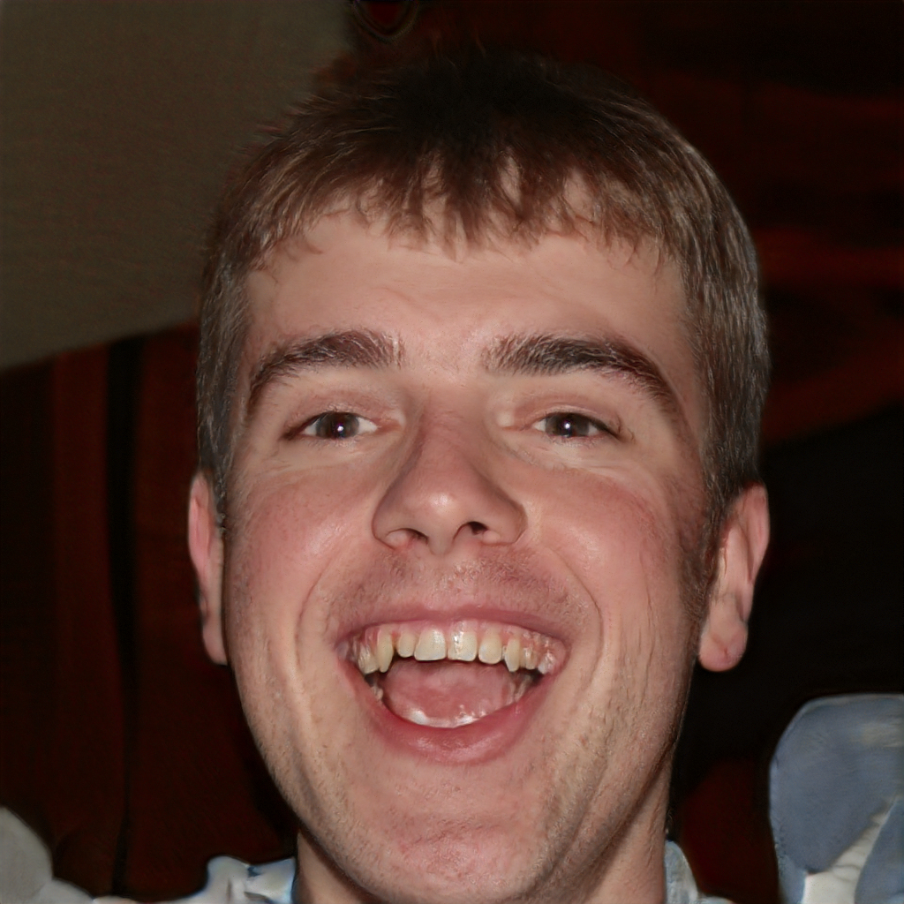
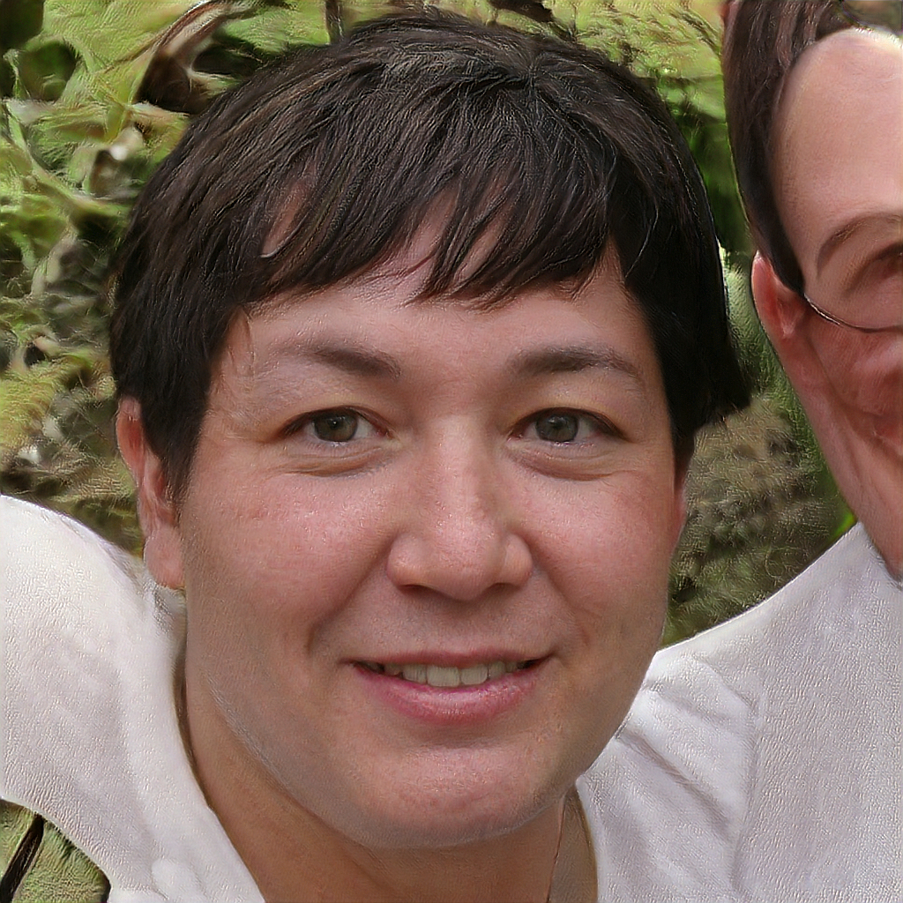
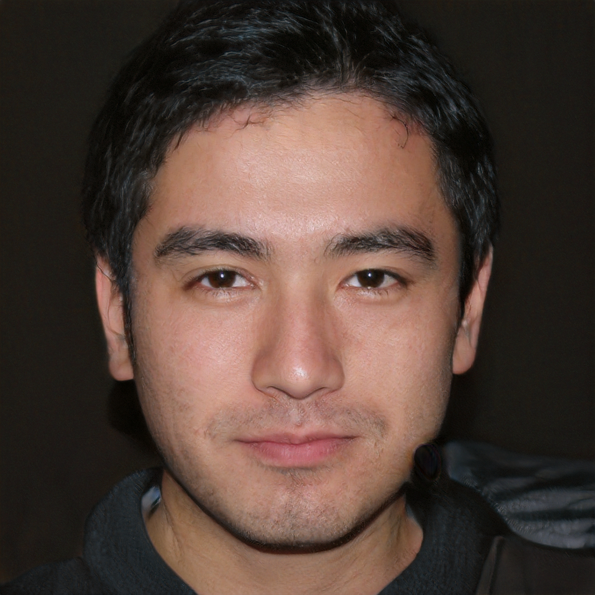
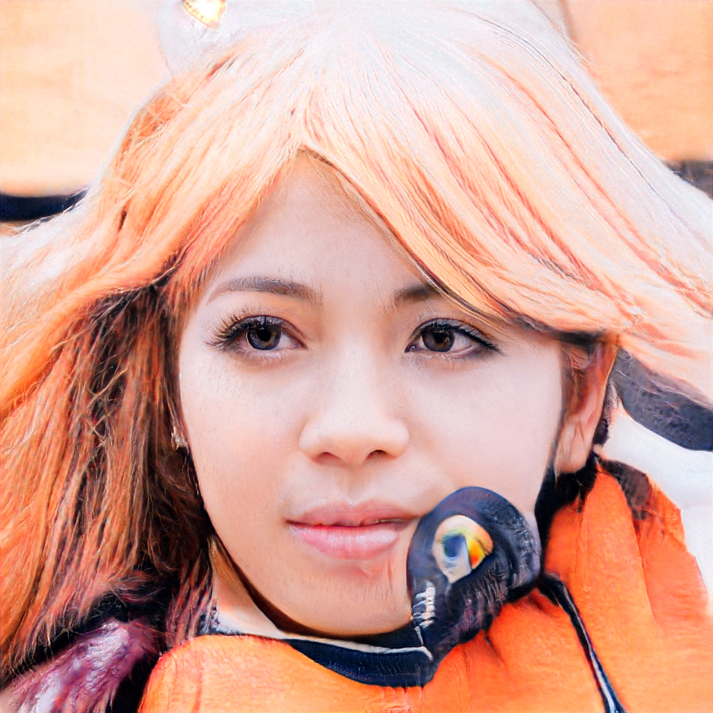
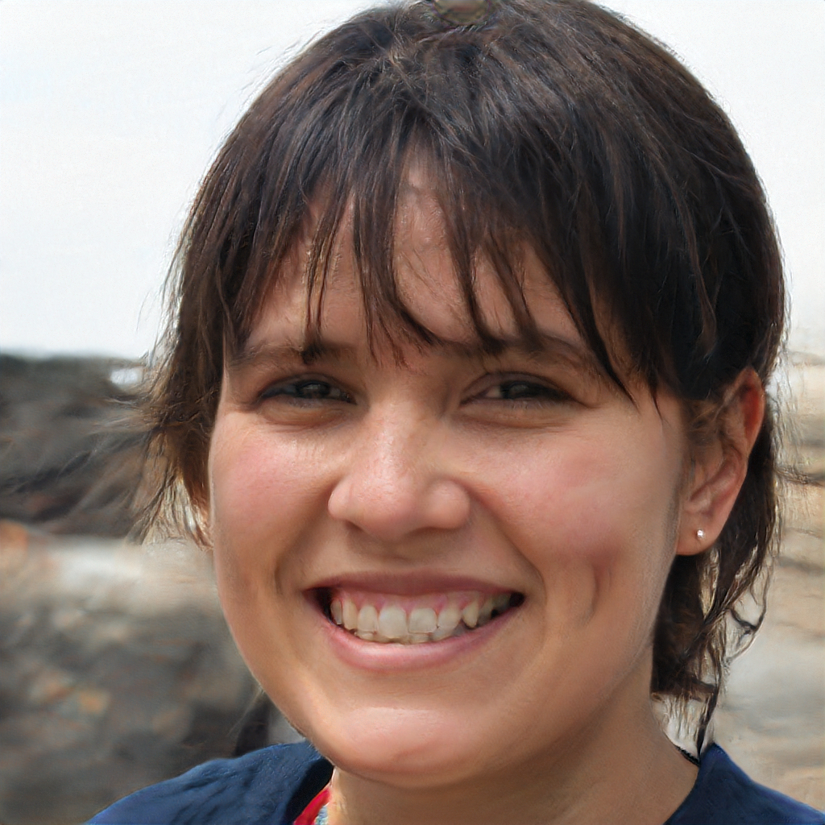
GAN ART
this person does not exist

Slide 17
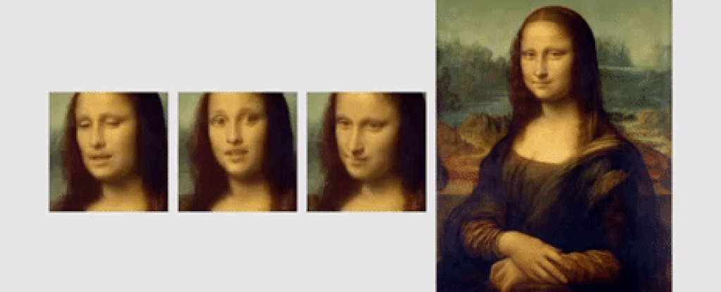
GAN ART
deepfakes

Slide 18

Recurrent Neural Networks (RNN)

Slide 19

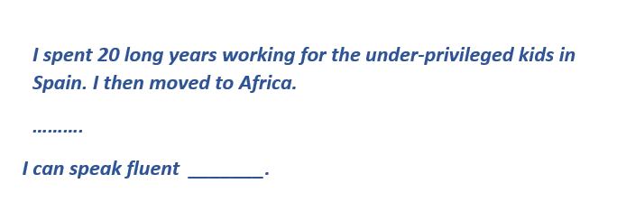
Recurrent Neural Networks (RNN)

